Slide 1

Healthcare Emergency Preparedness ECHO
Center for Disaster Medicine – Massachusetts General Hospital

Slide 2

Healthcare Emergency Preparedness ECHO 2026
Session 10: Digital Downtime Planning & Preparedness
June 18, 2026 12 – 1 PM ET | Virtual
Learning Objectives
Upon completion of this activity, participants will be able to:
  Identify (remember/understand) the clinical, operational, and patient safety risks associated with electronic health record (EHR) and IT system outages.
  Develop and share (create/apply) practical tools, lessons learned, or innovations that strengthen digital resilience and preparedness.
Target Audience
This activity is intended for physicians, nurses, emergency managers, and other healthcare or public health personnel with an interest in emergency preparedness.
Course Co-Directors
Eileen Searle, PhD, RN
Director of Funded Projects, Center for Disaster Medicine – Massachusetts General Hospital
Stacey Kokaram, MPH
Assistant Director of Funded Projects, Center for Disaster Medicine – Massachusetts General Hospital
Samantha Pellicane, MPH
Program Coordinator, Center for Disaster Medicine – Massachusetts General Hospital
Faculty
Sidney Allmendinger, MPH
Senior Program Manager, Emergency Preparedness – Newton Wellesley Hospital & McLean Hospital
Agenda
12:00pm | Welcome & Introductions | Eileen Searle, PhD, RN
12:05 | Digital Downtime Planning & Preparedness | Sidney Allmendinger, MPH
12:55 | Closing Remarks | Eileen Searle, PhD, RN
1:00pm | Adjournment
Accreditation
In support of improving patient care, Mass General Brigham is jointly accredited by the Accreditation Council for Continuing Medical Education (ACCME), the Accreditation Council for Pharmacy Education (ACPE), and the American Nurses Credentialing Center (ANCC), to provide continuing education for the healthcare team.
Credit Designation Statements
AMA PRA Category 1 CreditsTM
Mass General Brigham designates this live activity for a maximum of 1 AMA PRA Category 1 Credit™. Physicians should claim only the credit commensurate with the extent of their participation in the activity.
Nursing
Mass General Brigham designates this activity for 1 ANCC contact hour. Nurses should only claim credit commensurate with the extent of their participation in the activity.
Since the content of this activity is non-clinical, disclosure forms do not need to be collected for planners and speakers.

Slide 3
Disclosure Summary of Relevant Financial Relationships
MITIGATION STRATEGIES
Mass General Brigham has implemented a process to mitigate relevant financial relationships for this continuing education (CE) activity to help ensure content objectivity, independence, fair balance and ensure that the content is aligned with the interest of the public. All reviewers have no relevant relationships with ineligible companies.
The following planners have reported no relevant financial relationship with an ineligible company:
Paul Biddinger, MD Shawn D’Andrea, MD, MPH Eileen Searle, PhD, RN
Stacey Kokaram, MPH Samantha Pellicane, MPH Sid Allmendinger, MPH
The following planners have reported a relevant financial relationship with an ineligible company:
The following speakers have reported no financial relationships with an ineligible company:
The following speakers have reported financial relationships with an ineligible company:

Slide 4
Acknowledgement
This project is supported by Grant ID: 83677 Fund 3RVT1 Using the ECHO model to strengthen regional and national health emergency preparedness through cross-sector collaboration from the Robert Wood Johnson Foundation and a subaward from University of New Mexico Health Sciences Center.

Slide 5
Housekeeping
The recording and slides for today’s session will be made available on the iECHO course website (https://iecho.org/public/program/PRGM1762962323295U6HA0QSICH)
To limit background noise, please keep your microphone muted when not talking.
We encourage your questions and comments! If you have a question or comment at any point during the session, please type your questions into the chat.

Slide 6
Digital Downtime Planning and Preparedness
Sidney Allmendinger

Slide 7
Learning Objectives
Identify (remember/understand) the clinical, operational, and patient safety risks associated with electronic health record (EHR) and IT system outages.
Develop and share (create/apply) practical tools, lessons learned, or innovations that strengthen digital resilience and preparedness.

Slide 8
Introduction + Agenda
Agenda
Framing Digital Downtime Events
Downtime Planning Framework
Foundations of Readiness
Key Takeaways for Digital Downtime Planning and Preparedness
Sid Allmendinger
Sr. Manager, Mass General Brigham (MGB) Department of Emergency Preparedness & Continuity (DEPC)
Co-Chair of the MGB Enterprise Downtime Committee

Slide 9
What is a Digital Downtime Event?
Digital downtimes are events in which digital/information systems and technology are unavailable or unable to function as intended.
Planned or unplanned
Specific applications (i.e., Epic) or systems (i.e., network connectivity)
Operational impacts (i.e., revenue-related apps) and/or patient care impacts (pathology results reporting app)
Variable impacts to operations and workflows
Digital downtime events can result in:
Information loss → can’t see the data
Process breakdowns → manual workflows are the primary alternative
Reconciliation issues → incomplete picture after recovery
Notes:
Ask Eva for slides

Slide 10
Framing Digital Downtime Events
Digital downtime events are a patient safety risk. (and operational, too).
Increased utilization and reliance on technology to provide patient care results in a greater impact to workflows when this technology fails.
Medication errors due to reconciliations gaps.
Delays in critical test results.
Administrative burden of paper documentation further straining staff.
Inability to leverage typical communication tools.
Downtime events can affect the whole region, increasing ED wait times, slowing ambulance movement.
A growing threat.
Changing workforce with less experience using paper documentation.
Increasing frequency/threat of cyber attacks on critical infrastructure, specifically healthcare systems.
Notes:
Disruptions can impact the entire continuum of care; from scheduling a visit at an ambulatory clinic to clinical decision making in the ICU.
References:
Ransomware Attack Associated With Disruptions at Adjacent Emergency Departments in the US | Emergency Medicine | JAMA Network Open | JAMA Network
2025 Ponemon Healthcare Cybersecurity Report | Proofpoint US

Slide 11
Downtime Planning
Downtime readiness is a continuity capability – provides a hospital or system with the means to continue its operations (i.e., patient care) despite disruptions to critical systems.
Before the Downtime
Standardized downtime procedures
Training +drills
During the Downtime
Communication plan
EOP activation
After the Downtime
Operational alignment
Reconciliation
HICS integration
Utilization of downtime tools (i.e., paper)
After-action

Slide 12
Downtime Planning – A System Approach
Implement a Downtime Readiness Governance structure to support planning and implementation.
Amplifies front-line staff needs and challenges
Establishes consistent venue for coordination across departments/entities
Built on executive buy-in and mission driven
Leverage a committee & workgroup structure to organize initiatives.
Entity Committees identify front-line issues, support local implementation
Enterprise Committee facilitates gap analysis and develops priorities and projects.
Executive Committee ensures accountability for downtime readiness, approves major policies and priorities.

Slide 13
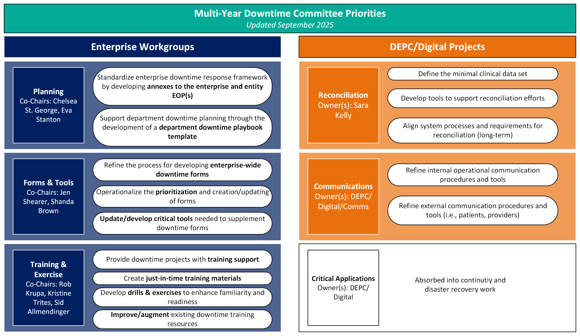
Downtime Planning – Start with a Gap Analysis
We conducted a system-wide gap analysis focused on the following categories:
Plans
Resources (primarily downtime forms and associated tools)
Training
We looked for:
What exists and what is missing
Who owns or supports this work currently

Slide 14
Downtime Planning – Establishing the Framework
Challenging!
Initial set of priorities focused on building a foundation of readiness that can be applied across all patient care areas.
Not intended to solve all the known issues upfront but provide the baseline readiness and a framework to build upon.

Slide 15
Foundations of Readiness
Downtime annexes integrated into Emergency Operations Plans to support continuity of care during a response.
Standardized downtime forms used to improve consistency across clinical and operational scenarios.
Department-specific procedures used to prioritize essential functions and direct alternative workflows.
Centralized access to resources during uptime and downtime, including local downtime kits, to support version control and practical access during events.
Role-based Job Action Sheets to provide just-in-time training to front-line staff during downtime events.
Recurring unit-based downtime skills drills to strengthen front-line staff confidence and familiarity with downtime procedures.

Slide 16
Foundations of Readiness – Role-based Perspective
Roles & Responsibilities |  | Trainings
Front line staff need to be familiar with downtime procedures to continue to deliver quality care during a digital downtime. |  | Unit-based downtime skills drills Annual required downtime training
Unit leadership (MD, RN, Administrative) need to be experts in downtime procedures to be prepared to support front line staff in the delivery of quality care during a downtime. |  | Unit-based downtime skills drills (facilitator) Annual required downtime training Downtime superuser training
Senior leaders need to be familiar with entity and enterprise response to downtimes to be prepared to lead their entity’s response to a downtime. |  | Familiarity with HICS and enterprise/entity downtime protocols, participation in entity downtime exercises
Downtime Committees (Entity, Enterprise, Executive) provide ongoing evaluation of downtime readiness efforts through exercises and metrics.

Slide 17
Key Takeaways for Digital Downtime Planning and Preparedness
Digital downtime events are a patient safety issue.
Downtime readiness is a moving target and requires iterative planning; start with a gap analysis and defined priorities.
Implement a foundation that can be built upon; create a governance structure and start with the basics (i.e., access to downtime paper forms and BCA devices)
Recovery can pose just as large of a risk as the actual downtime; ensure recovery/reconciliation is part of your planning.

Slide 18
Case Presentation

Slide 19
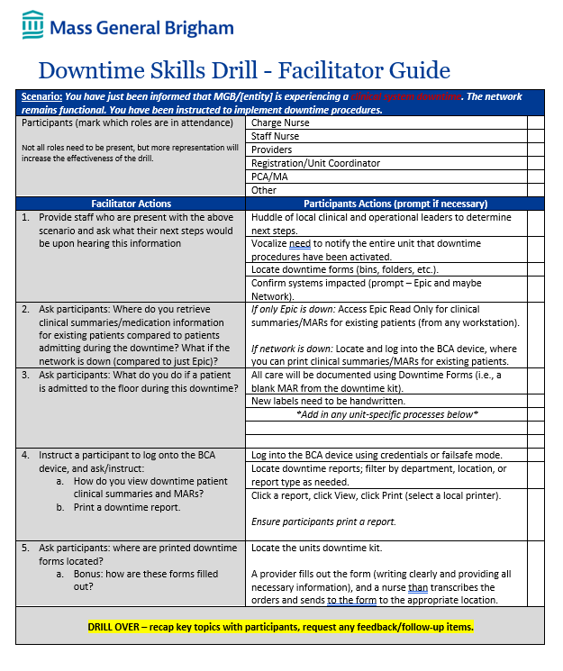
Case Presentation: Downtime Skills Drills
Unit-level downtime drills
Staff must respond using downtime procedures
Focus on real-time decision-making and actions
Notes:
This case is based on our Downtime Skills Drills Toolkit, which is designed to simulate a real downtime and prompt frontline staff to take action. Instead of presenting a theoretical case, this is a structured exercise used across units.

Slide 20
Downtime Skills Drills – The Goal
Intended to reinforce the essential basics that front-line staff need to know to continue providing patient care during a downtime.
Build familiarity with downtime procedures.
Reinforce use of downtime tools and resources.
Provide hands-on practice for frontline staff .
Notes:
The intent is not to teach new concepts—it’s to build muscle memory. Staff should leave the drill knowing exactly what to do when downtime happens, not just understanding it conceptually.

Slide 21
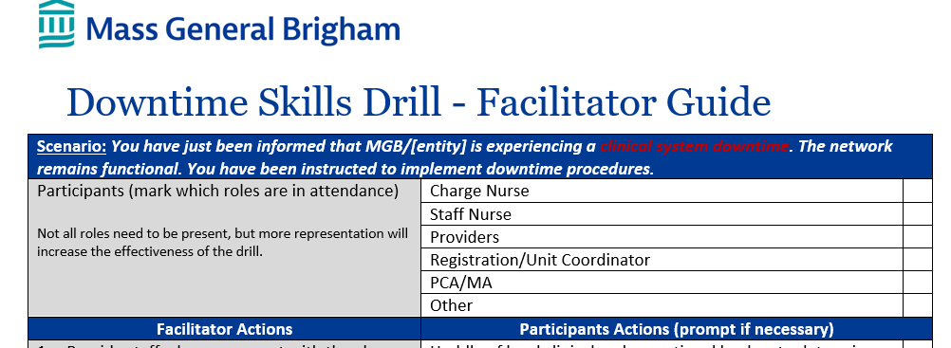
Downtime Skills Drills – Audience
Unit-based exercise
Participants include:
Nurses
Providers
PCAs / Mas
Registration / coordinators
Facilitated by:
Clinical educators
Nurse leaders
Intended to take ~15 minutes
Notes:
This is designed to be interdisciplinary and localized. The more representation you have, the more realistic and effective the drill becomes.

Slide 22
Scenario
Facilitators should approach staff unannounced at the nurse's station.
Scenario:
A clinical system downtime has just occurred.
The network remains functional.
Downtime procedures must be activated.
Notes:
This is intentionally simple. The goal is to simulate the moment of notification—when confusion and variability are highest—and see how teams respond.

Slide 23
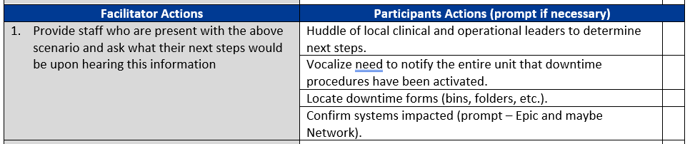
First Actions: What Should Happen Immediately
“Correct” response available to facilitators
Participants are prompted to describe their initial actions upon hearing this information.
Huddle clinical and operational leaders
Communicate downtime activation to unit
Locate downtime forms
Confirm which systems are impacted
Notes:
These are the first 5–10 minutes of downtime, which are often the highest-risk period. The drill reinforces that communication and coordination come before execution

Slide 24
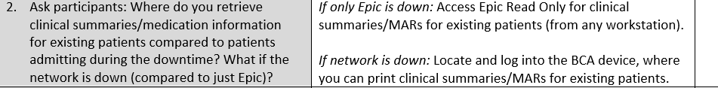
Core Skill 1: Accessing Patient Information
Participants asked where patient information can be found, and to physically do so using these methods during the drill.
What if Epic is down?
What if the network is down?
Notes:
This is one of the most critical skills. Staff must know where to get patient information depending on what is down. The drill forces them to think through this distinction in real time.

Slide 25
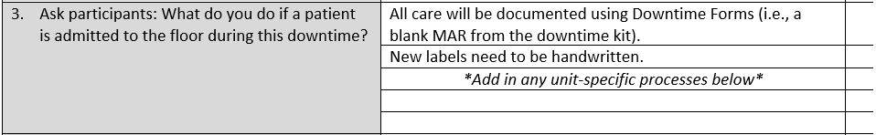
Core Skill 2: Admitting New Patients
Participants asked to define the process for admitting a new patient to the floor during a downtime.
Using downtime forms for all documentation
Creating handwritten labels
Identify any unit-specific workflows
Notes:
This reinforces that new workflows are required, not workarounds within the system. It’s a full transition to paper-based care processes

Slide 26
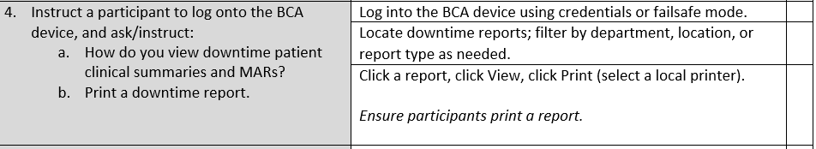
Core Skill 3: Using the BCA Device
Participants are asked to log onto the BCA device and conduct essential tasks:
Verify device/credentials work
Locate downtime reports (patients)
Print reports (ensuring downtime printer works)
Notes:
This is where the drill becomes truly operational. It’s not enough to know that BCA devices exist—staff must physically log in and print reports.

Slide 27
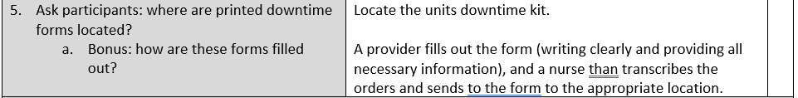
Core Skill 4: Using Downtime Forms Correctly
Participants are asked to locate and practice filling out a downtime form with real patient information.
Ensures awareness of and access to downtime toolkits
Clarify role of provider vs nurse
Emphasizes need to properly document by hand all necessary information
Notes:
This reinforces proper role clarity. Downtime introduces risk of miscommunication, so clearly defined responsibilities are critical

Slide 28
Closing the Loop: After the Drill
Facilitator is then asked to help close the loop:
Provide participants with an overview of the drill and key topics
Share lessons learned at a staff meeting
Leverage existing resources to troubleshoot identified issues/gaps
Engage with local Downtime Committee for further support, drill improvement, etc.
Notes:
This is where the drill becomes part of a continuous improvement cycle. The goal is not just practice—it’s system-level improvement

Slide 29
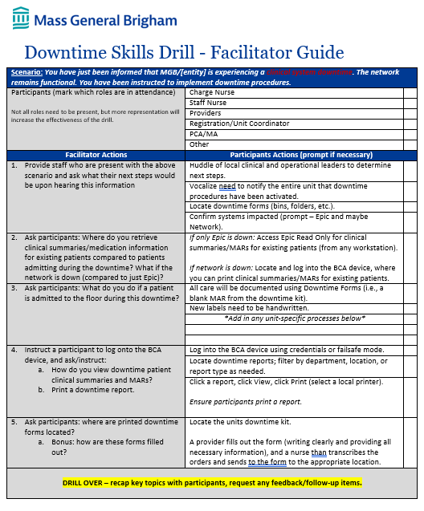
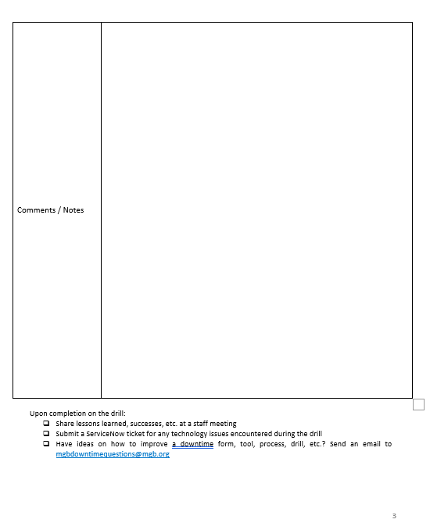
Downtime Skills Drills – Reinforcing the Basics
These drills reinforce:
Communication during uncertainty
Role clarity
Access to critical patient information
Safe documentation practices
Familiarity with tools before an event
Notes:
The value of the drill is that it focuses on simple, high-risk tasks. These are the areas where failure is most likely to occur in a real downtime

Slide 30

Questions
Notes:
* 2nd polling opportunity

Slide 31


Thank you!
mghcdm@partners.org
massgeneral.org/disaster-medicine
@MGHDisasterMed
ECHO@salud.unm.edu
https://projectecho.unm.edu/
@ProjectECHO
Center for Disaster Medicine – Region 1 Disaster Health Response System and Regional Emerging Special Pathogens Treatment Center

